Slide 1
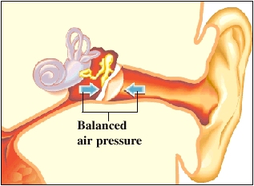
Medical physics first year
L7
Pressure in body
By Assistants professor
Dr. Mohammed Ali Jaber
Physiology Department
College of Medicine
University of Basrah

Slide 2
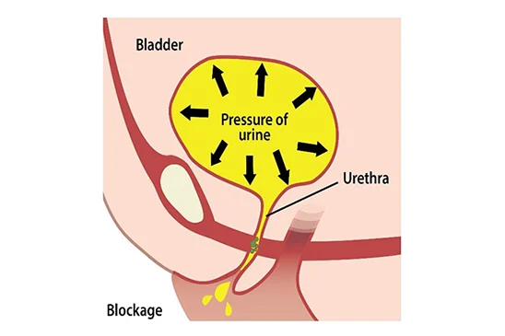
Pressure in the urinary bladder
Bladder pressure climbs steadily from zero to about 30cmH₂O as the bladder fills to its normal capacity of 500 cm³ .
The interval pressure in the bladder is due to the accumulation of urine. For adult, the typical maximum volume in the bladder before voiding is 500ml.

Slide 3
At some pressure nearly 30cmH₂O the micturition reflex(Urination, ) occurs.
Stimulates the feeling of needing to urinate
Causes muscles around the bladder to contract
The resulting sizable muscular contraction in the bladder wall produces a momentary pressure of up to 150cmH₂O .
The bladder pressure increases during coughing , straining , sitting up , also during pregnancy the weight of fetus over the bladder increase the bladder pressure and causes frequent urination.

Slide 4
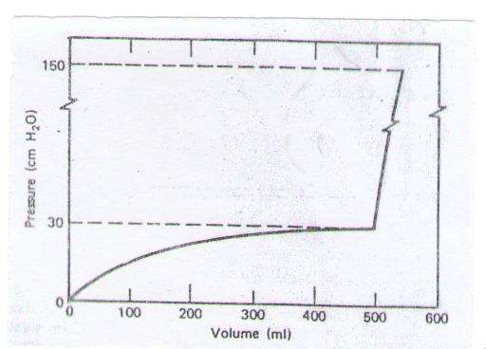
The figure below shows the typical pressure volume curves for the bladder, which stretches as the volume increase.

Slide 5
Normal voiding pressure is fairly low (20 – 40) cm H₂O but for men who suffer from prostate obstruction of the urinary passage it may be over 100 cm H₂O
Probably the most typical reason for bladder pressure is cystitis or inflammation of the bladder, prostatitis, Uterine fibroids, Ovarian cancer and Urinary system infection.
One hazard of high bladder pressure (sometimes created by an obstruction), is that such pressure can force urine back into the kidneys, causing potentially severe damage.

Slide 6
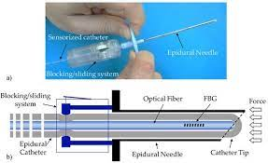
The pressure in the bladder can be measured:
By passing a catheter with a pressure sensor into the bladder through the urinary passage (urethra).
By a needle inserted through the wall of the abdomen directly into the bladder. This technique gives information about the function of the exit valves that cannot be obtained with the catheter technique.

Slide 7
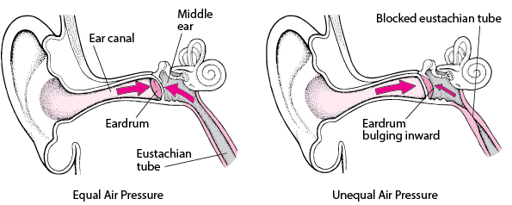
Pressure in ear
The middle ear is one of the air cavities that exist within the body.
For comfort, .
P( middle ear )=P (outside eardrum)
This equalized is produced by air flowing through the Eustachian tube,
Which is usually closed except during swallowing, chewing, and yawning

Slide 8
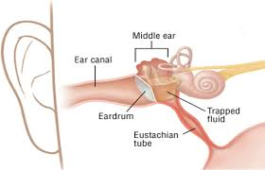
Pressure in the middle ear can result in significant force on the eardrum if it differs greatly from atmospheric pressure, such as while scuba diving.
The decrease in external pressure is also noticeable during plane flights (due to a decrease in the weight of air above relative to that at the Earth’s surface).
The Eustachian tubes connect the middle ear to the throat and allow us to equalize pressure in the middle ear to avoid an imbalance of force on the eardrum.

Slide 9
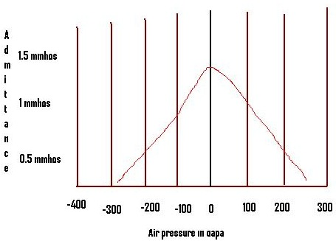
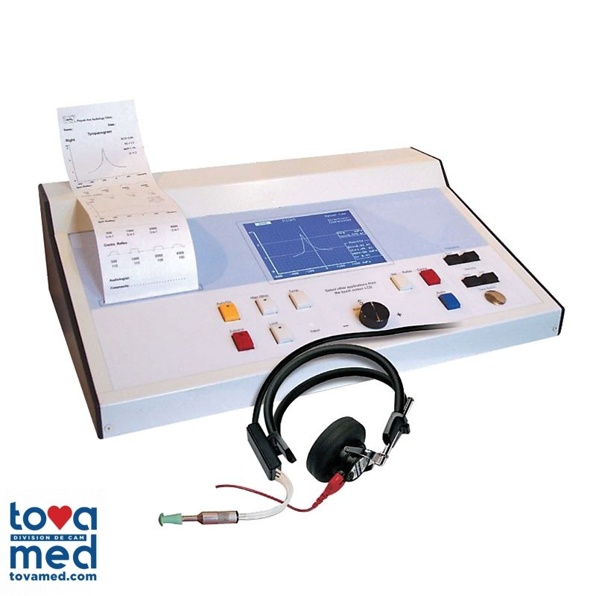
How is ear pressure measured?
Tympanometry: A test that measures the air pressure in the middle ear.
Tympanometer: The device a clinician uses to perform a tympanometry test.
Tympanogram: The test results plotted on a chart.
Normal middle ear pressure should be somewhere between +50 to –150 Pa (mm water).

Slide 10
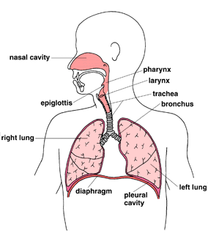
Pressure effects while diving
The body is composed primarily of solids and liquids, which are nearly incompressible.
There are gas cavities in the body where sudden pressure changes can produce profound effects.

Slide 11
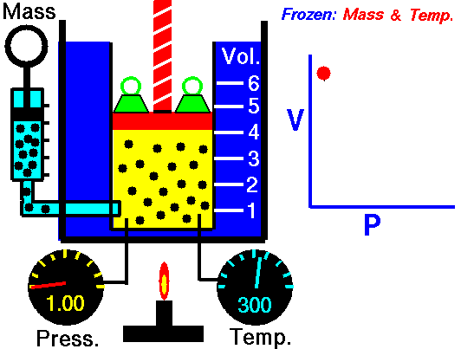
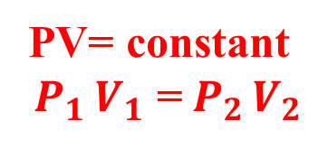
Boyles law
For a fixed quantity of gas and fixed temperature
Pressure is directly proportional to the reciprocal of volume
Pα $\frac{1}{V}$

Slide 12
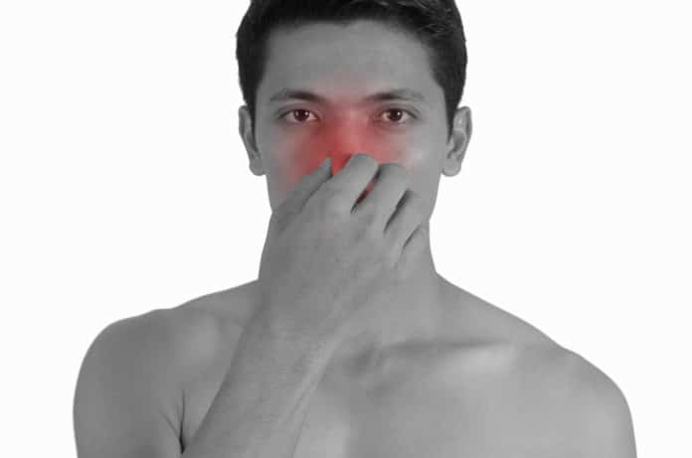
When diving many people has difficulty obtaining pressure equalization and feels pressure on their ears.
(120mmHg) across the eardrum 1.7 m of water (can cause damage (rupture) to the eardrum .)
One method of equalization used by diver is to raise the pressure in the mouth by holding the nose and trying to blow .

Slide 13
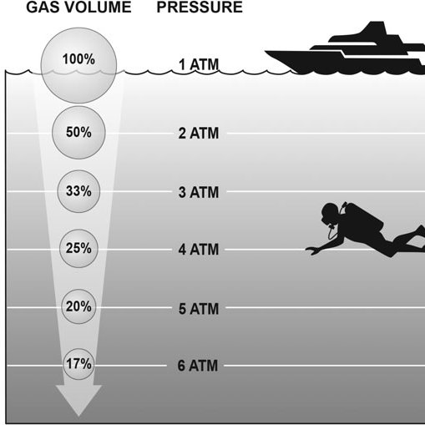
Boyle's Law describes the role of water pressure in the dive environment.
It applies and affects many aspects of scuba diving. Consider the following examples:
• Descent - As a diver descends, the water pressure around him increases, causing air in his scuba equipment and body to occupy a smaller volume (compress).
• Ascent - As a diver ascends, water pressure decreases, so Boyle's Law states that the air in his gear and body expand to occupy a greater volume.

Slide 14
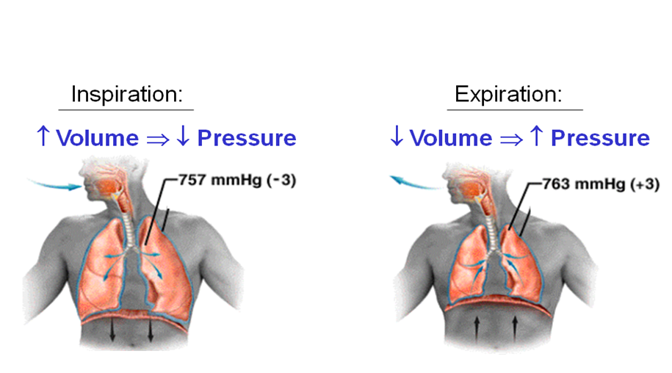
The pressure in the lung
In the lung
P at any depth >> P at sea level.
The air in the lung is denser under water. ($ρ=\frac{m}{v}$ )
&
The partial pressure of all the air components are proportionately higher

Slide 15
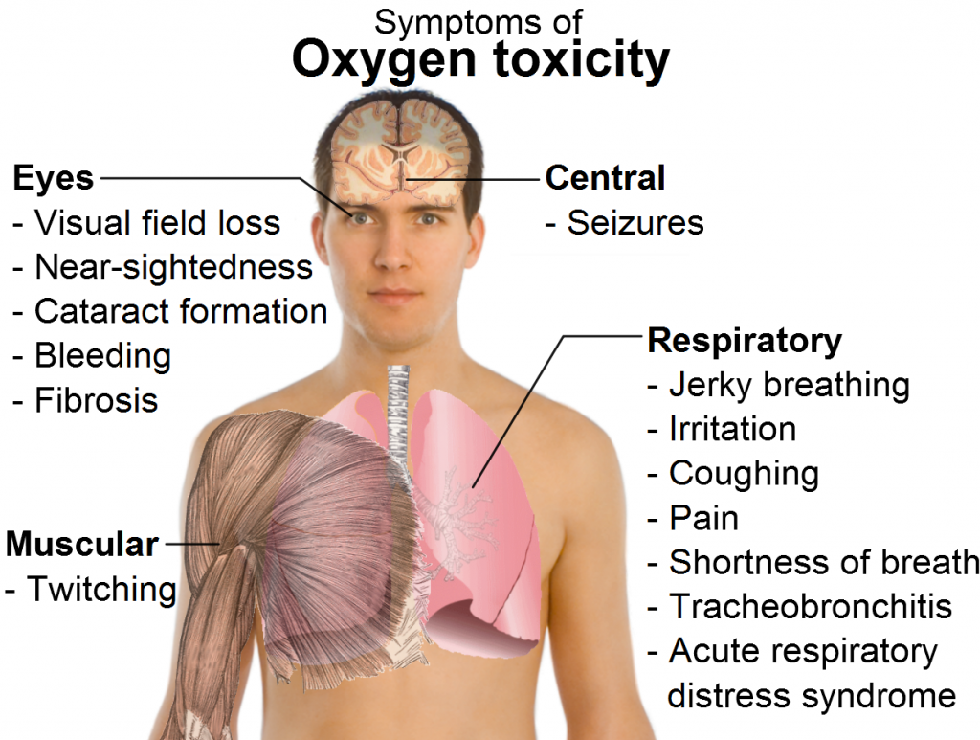
1-
Higher P O₂
More O₂ molecules to be transformed into the blood
Results
Oxygen poisoning
(if the partial pressure of the O₂ gets high.))
At depth of 30m PO₂ is 0.8 atm and $P_{abs}$ is 4 atm

Slide 16
2-
Breathing air at a depth of 30m
Dangerous because it may result in
Excess N₂ in the blood and tissues,
Nitrogen narcosis (intoxication effect)
The bends or decompression sickness (a scant problem).

Slide 17
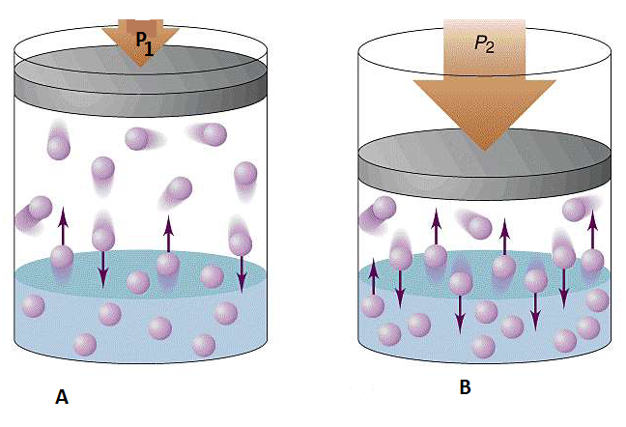
O₂ is attached to red blood cells, while N₂ is dissolved in the blood and tissues, according to Henrys law
Henrys law
The amount of gas that will dissolve in a liquid is proportional to the partial pressure of the gas in contact with the liquid.

Slide 18
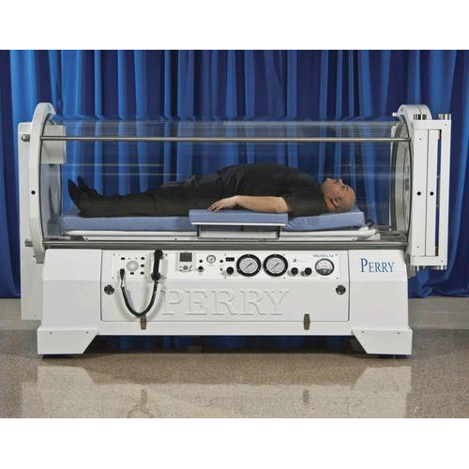
Hyperbaric oxygen therapy(HOT)
The body normally lives in an atmosphere (1/5 O₂ &4/5 N₂ ).
In some medical situations, it is beneficial to increase the proportion of O₂ in order to provide more O₂ to the tissue.
A patient receives treatment with Hyperbaric oxygen chamber
Hyperbaric oxygen therapy (HOT): the medical use of oxygen at an ambient pressure higher than atmospheric pressure.

Slide 19
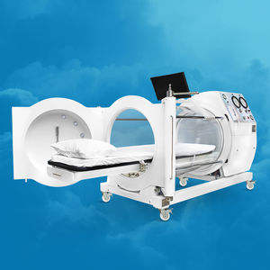
The equipment required for hyperbaric oxygen treatment consists of a pressure chamber, which may be of rigid or flexible construction, and a means of delivering 100% oxygen.

Slide 20
In a hyperbaric oxygen therapy chamber, P(air) increased two to three times higher than normal air pressure.
Under these conditions, your lungs can gather much more oxygen than would be possible breathing pure oxygen at normal air pressure.
When your blood carries this extra oxygen throughout your body, this helps fight bacteria and stimulate the release of substances called growth factors and stem cells, which promote healing.

Slide 21
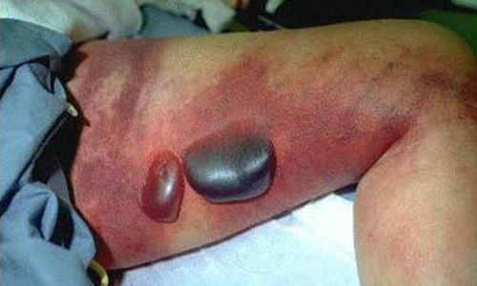
1-Gas gangrene:
Gangrene refers to the death of body tissue due to either a lack of blood flow or a serious bacterial infection.
The bacillus causes gas gangrene then it's treated with (HOT). That is due to bacillus cannot survive in the presence of oxygen
The oxygen saturates the infected tissues and thereby prevents the growth of the bacteria (bacillus) causes it.

Slide 22
2-Carbon monoxide poisoning:
-In carbon monoxide poisoning
RBC cannot carry O₂ to the tissues because CO faster to the hemoglobin at the places normally used by O₂ .
-Normally the amount of O₂ dissolved in the blood is about 2% of that carried on the RBC
By using the (HOT) technique the PO2
15 times
Permitting enough O2 to be dissolved to fill the body's needs .

Slide 23
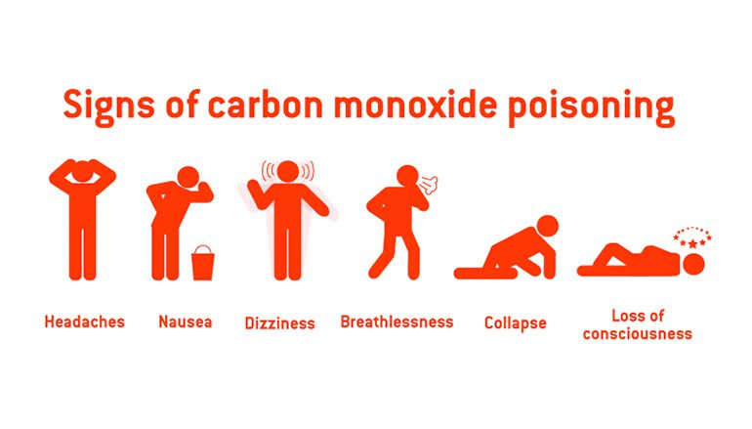

Slide 24
3-Treatment of cancer:
Hyperbaric oxygen may increase the amount of oxygen in cancer cells, which may make them easier to kill with radiation therapy and chemotherapy.
It is a type of radiosensitizing agent and a type of chemosensitizing agent.
The theory was that more oxygen would make the poorly oxygenated radiation –resistant cell in the center of the tumor more susceptible to radiation damage.
(HOT) with radiation is given to the patient in transparent plastic tank.

Slide 25
Thank you

